Slide 2
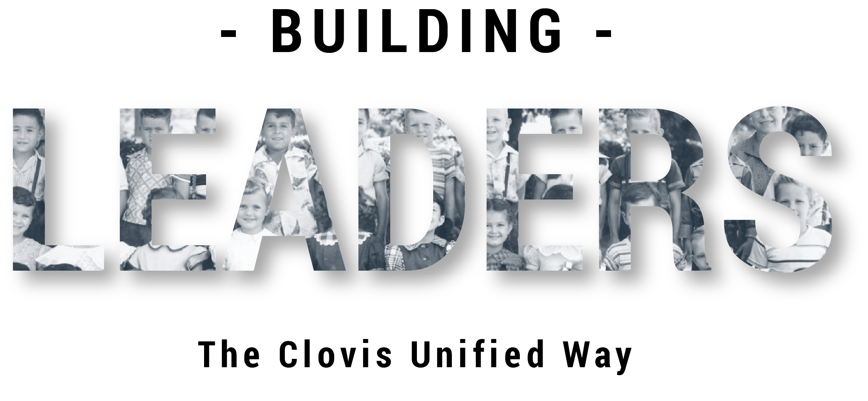
Competition is an Ingredient of High Standards

Slide 3
Part II
Notes:
Facilitator:
The purpose of Part II is to go more deeply into the philosophies and values of our district. We examine how to apply the philosophy, generally using local resources and interviews of past and present leaders.

Slide 4
Three Levels of Competition
We recognize three level of competitions. First, we want you to make sure that all of our students learn to complete against, themselves; that’s the toughest competition of all.”
Doc’s Charge
Notes:
Script: Tier I, II, III
Facilitator:
Competition is a core value in Clovis Unified. At times, in the past and even today we are criticized because of the value we place on competition. But when you understand the three levels of competition and the purpose of each you have a much better understanding of the value and how it should be applied. The three levels of competition are:
Compete against yourself (personal best)
Compete in specialty areas (student council, art, tennis)
Compete in groups (choir, band, Destination Imagination, football)
Discussion Points:
Let’s read the first level of competition…compete against yourself. In small groups discuss the following:
301 – Why is competing against yourself the toughest competition of all? Explain your thinking.
302 – What are some ways you currently compete against yourself? How does CUSD help students learn to compete against themselves?
303 - What do you learn when competing against yourself? What do kids learn by competing with themselves?
After everyone is done ask each group to share one of their examples.

Slide 5
Three Levels of Competition
“Second, we want you to encourage our students to compete in specialty areas to help them build their strengths and overcome their weaknesses, because that’s the way they get jobs and that’s the way they have to perform in life.”
Notes:
Script: Tiers I, II, III
Facilitator:
Doc believed that competition served as a motivational tool, especially for children. He believed in three levels of competition. The second level of competition is to compete in specialty areas.
Please read about the second level of competition from Doc’s Charge. Facilitator may read or choose someone to read.
Discussion Points:
In small groups of 3 discuss one or more of the following (facilitators choice).
101 – List examples of specialty areas available to students in CUSD? Are there other we should offer? If so, what would you recommend?
201 – How does competition help you build upon your strengths? How does it help you overcome your weaknesses? Use specific examples to explain your answer.
301 – Have you or your children ever competed in a specialty area? If so, share with the group and discuss what you learned from the experience.
After everyone is done ask each group to share one of their examples.

Slide 6
Three Levels of Competition
“Third, we want you to teach our students to work in groups and to compete in groups because we think that students who can’t work in groups are going to have trouble in tomorrow’s world.”
Notes:
Script: Tier I, II, III
Facilitator:
Today we hear a lot about the importance of soft-skills in the job force, like the ability to collaborate with others. As Janet Young would often say, “Doc was an educational genius.” Just think 60 years ago this was a core value of our district. Ask participants to read the third level of competition. Popcorn read, read altogether, or facilitator may read.
Discussion Points:
Participants may remain in small groups to discuss one or more of the following (facilitators choice).
101 – Why is it important to work and compete in groups? Think about your site and/or department how do you work in groups? How do you compete? Provide specific examples.
201 – Fifty years ago Doc said that students who can’t work in groups are going to have trouble in today’s world? Is this statement still true? Explain your thinking.
301 – Doc applied his philosophies to children. Do you think they apply to adults, as well? Explain why or why not. Provide specific examples.
After everyone is done ask each group to share one of their examples.

Slide 7
The Sparthenian Concept
“The recipients of this award truly exemplify the concept of the Clovis Sparthenian...to "be the best you can be in mind, body, and spirit." In essence, the award comes through goal setting, hard work, participation, and follow-through....the ingredients of life-long learning and success.”
Riverview Elementary School
Notes:
Script: Tier I, II, III
Facilitator:
As we talk about competition in Clovis Unified it’s important that we understand the “why” behind the “what” of our competition model. We did a google search for the Sparthenian concept, and this was one of the many Clovis school sites that “popped up”. Please read the explanation of the Sparthenian Concept from Riverview and see how closely it aligns/matches your definition of a Clovis Sparthenian.
For the 50th anniversary of CUSD all employees received a copy of the book 50 Unified Years – Building a Tradition of Excellence in Clovis Unifies, During and After Unification. It was compiled and edited by Susan Sawyer and Kelly Avants. The book provides a history of our district and each elementary school that was built when the book was published in 2011.
Discussion Points:
In a small group read about The Sparthenian Concept, Accountability Model, and Competition model on pages 7 - 10 in the 50 Unified Years book (included in resource folder). Then discuss/answer one or more of the following (facilitator choice).
101 – What two words combine to create the word Sparthenian? Explain the Sparthenian concept. Use specific examples. Is the Sparthenian concept still of value in CUSD? Explain why or why not using examples.
201 – Why was the competition model originally implemented? Did it serve its purpose. Explain your answer.
301 – Identify the pluses and minuses of the Sparthenian concept. Is the Sparthenian concept still important to the success of students in CUSD?. Explain your reasoning.
Allow each group to share one of their responses.

Slide 8
Competition is an ingredient of high standards.
Doc’s Charge
Dr. Buchanan and Clovis unified was criticized by educators throughout the state for the level of competition that drove Clovis unified schools.
Terry Bradley, Ed.D.
The notion of competition when doc started, was very controversial. Then 20 years later, we have the state putting state scores on the front pages of the newspaper and really creating a ranking system.
Virginia Boris, Ed.D.
Ultimately that whole competitive thing really led to doc's been removed by the board.
Jim Fugman, Ed.D.
Notes:
Script: Tier III
Facilitator:
Today we are going to look more deeply at the competition mode and it’s impact on Clovis Unified. In the video you hear Dr. Boris, Dr. Fugman, and Dr. Kaiser talk about the how the competition model became controversial and eventually led to Doc’s contract not being renewed in 1991. (Video on next slide)
Discussion Points:
101 - In your opinion why was the competition model controversial? Do you agree? Explain your thinking.
201 – CUSD continues to compete at many levels; individual students, teams, schools, and as a district. List some of the ways we continue to compete. Are any of them controversial? If so, explain which ones and why. If not, explain your reasoning.
301 - Let’s take some time to examine our current accountability system, beginning with the Clovis Assessment System for Sustained Improvement (CLASSI) (summary included in resource folder). Is CLASSI still relevant? Explain why or why not. Do changes need to be made? If so, explain what they are and why they should be made. If not, explain your thinking.

Slide 9
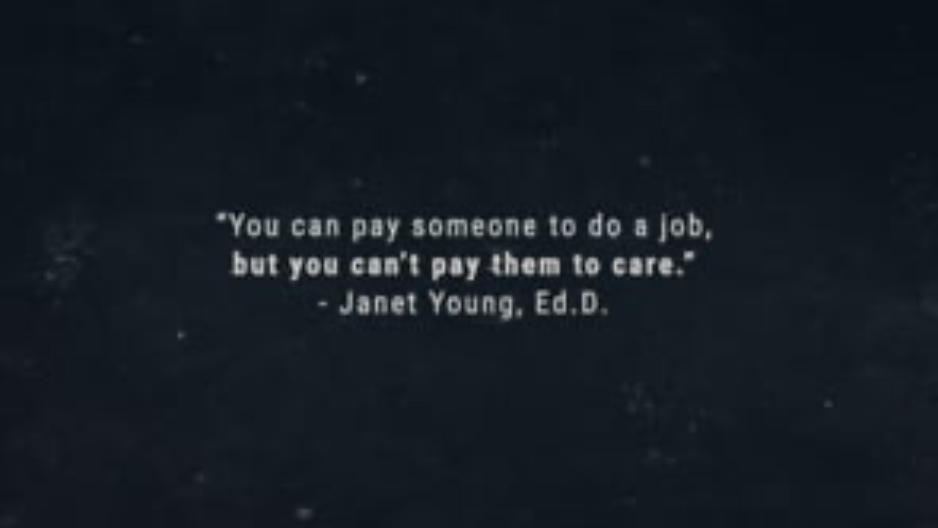

Slide 10
End of Part II
Notes:
Facilitator:
Depending on your time allocation and the audience you have several options.
The PowerPoint is designed for you to use the slides you choose in any order.

Slide 11


